Slide 1
Addition and Subtraction
Addition is just what you would expect in computers
Digits are added bit by bit from right to left
The carries are passed to the next digit to the left
Subtraction uses addition
The appropriate operand is simply negated before being added

Slide 2

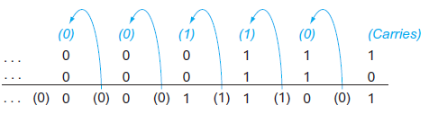

Addition and Subtraction
Let’s try adding $6_{ten}$ to $7_{ten}$ in binary

Slide 3



Addition and Subtraction
Let’s try subtracting $6_{ten}$ to $7_{ten}$ in binary

Slide 4
Overflow
Recall that overflow occurs when the result from an operation cannot be represented with the available hardware, in this case a 32-bit word
When can overflow occur in addition?
When adding operands with different signs, overflow cannot occur
The reason is the sum must be no larger than one of the operands
For example: -10 + 4 = -6
Since the operands fit in 32 bits and the sum is no larger than an operand, the sum must fit in 32 bits as well

Slide 5
Overflow
For subtract it’s just the opposite principle.
When the signs of the operands are the same, overflow cannot occur
To see this, remember that:
c – a = c + ( - a )
Therefore, when we subtract operands of the same sign we end up by adding operands of different signs

Slide 6
Overflow
How do we detect overflow when it does occur?
Clearly, adding or subtracting two 32-bit numbers can yield a result that needs 33 bits to be fully expressed
The lack of a 33rd bit means that when overflow occurs, the sign bit is set with the value of the result instead of the proper sign of the result
Hence, overflow occurs when adding two positive numbers and the sum is negative, or vice versa
Notes:
Just one extra bit because 32b + 32b = 33bits
Since we need just one extra bit, only the sign bit can be wrong

Slide 7
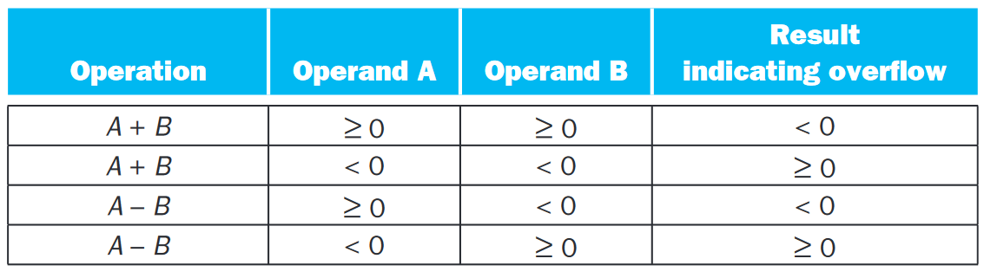

Slide 8
Overflow
What about overflow with unsigned integers?
Unsigned integers are commonly used for memory addresses where overflows are ignored.
The computer designer must therefore provide a way to ignore overflow in some cases and to recognize it in others.
■ Add (add), add immediate (addi), and subtract (sub) cause exceptions on overflow
■ Add unsigned (addu), add immediate unsigned (addiu), and subtract unsigned (subu) do not cause exceptions on overflow
Notes:
Because C ignores overflows, the MIPS C compilers will always generate the unsigned versions of the arithmetic instructions addu, addiu, and subu, no matter what the type of the variables.

Slide 9
Multiplication
The number of digits in the product is considerably larger than the number in either the multiplicand or the multiplier
In fact, if we ignore the sign bits, the length of the multiplication of an n-bit multiplicand and an m-bit multiplier is a product that is
n + m bits long
Hence, like add, multiply must cope with overflow

Slide 10
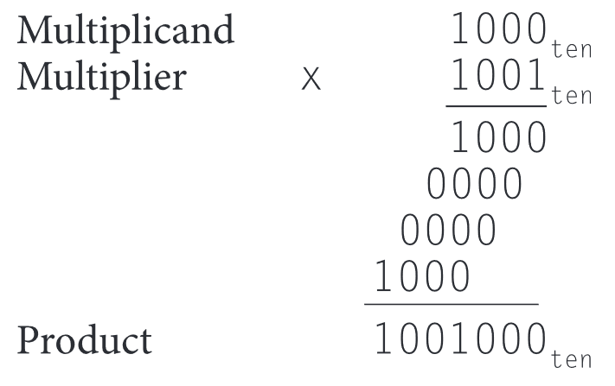
Notes:
In case 1 in multiplier: Just place a copy of the multiplicand (1 multiplicand) in the proper place.
In case 0 in multiplier: Place 0 (0 multiplicand) in the proper place.

Slide 11
Multiplication in hardware
Let’s assume that the multiplier is in the 32-bit Multiplier register and that the 64-bit Product register is initialized to 0
It’s clear that we will need to move the multiplicand left one digit each step, as it may be added to the intermediate products.
Over 32 steps, a 32-bit multiplicand would move 32 bits to the left .
Hence, we need a 64-bit Multiplicand register, initialized with the 32-bit multiplicand in the right half and zero in the left half.

Slide 12
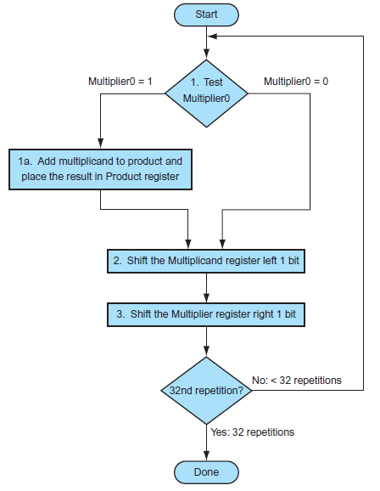

Slide 13
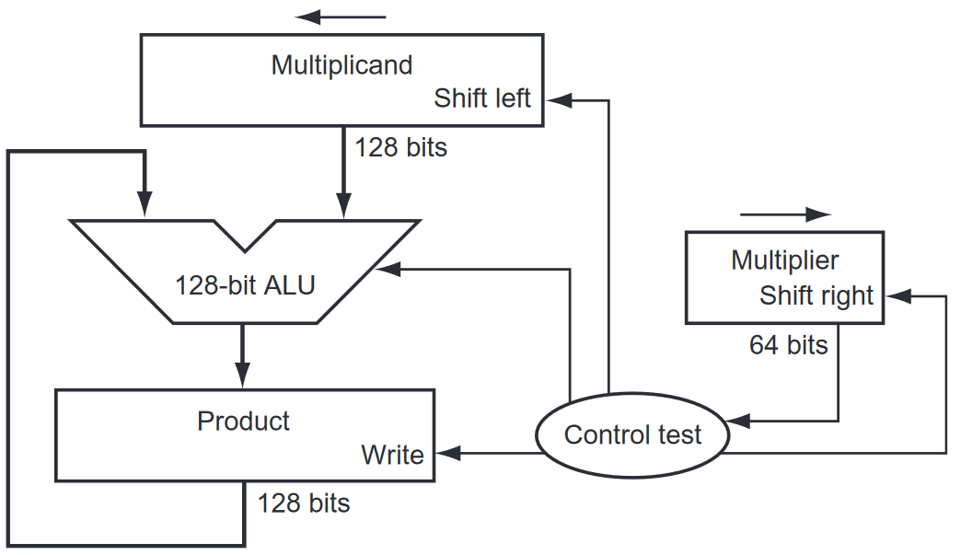
The left shift has the effect of moving the intermediate operands to the left
The least significant bit of the multiplier (Multiplier0) determines whether the multiplicand is added to the Product register
The shift right gives us the next bit of the multiplier to examine in the following iteration
Add Multiplicand to Product If 1 in least significant bit of the multiplier
Notes:
ALU is just doing addition
If 1, add multiplicant to product and place the result in product

Slide 14
Multiplication in hardware
These three steps are repeated 32 times to obtain the product
If each step took a clock cycle, this algorithm would require almost 100 clock cycles to multiply two 32-bit numbers
Addition and subtraction may be anywhere from 5 to 100 times more popular than multiply

Slide 15
Multiplication in hardware
This algorithm and hardware are easily refined to take 1 clock cycle per step.
The speed-up comes from performing the operations in parallel:
The multiplier and multiplicand are shifted while the multiplicand is added to the product if the multiplier bit is a 1
The hardware just has to ensure that it tests the right bit of the multiplier and gets the pre-shifted version of the multiplicand

Slide 16
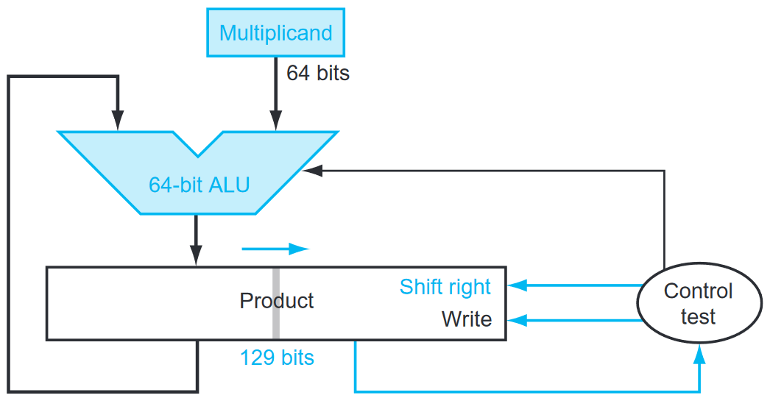
Now the product is shifted right
The multiplier is placed in the right half of the Product register.
Notes:
* The Multiplicand register, ALU, and Multiplier register are all 32 bits wide, with only the Product register left at 64 bits.
* The Product register should really be 65 bits to hold the carry out of the adder.

Slide 17
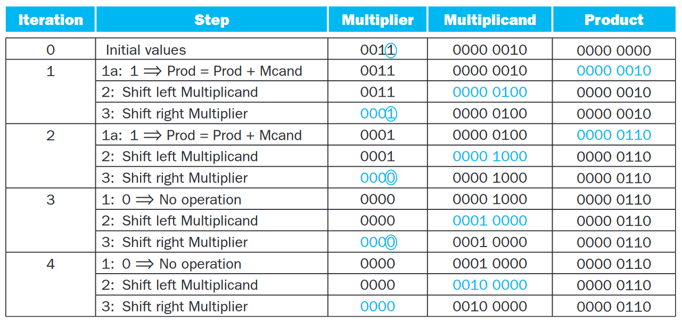

Slide 18
Signed Multiplication
First convert the multiplier and multiplicand to positive numbers and then remember the original signs
The algorithms should then be run for 31 iterations, leaving the signs out of the calculation
We need negate the product only if the original signs disagree
The shifting steps would need to extend the sign of the product for signed numbers
When the algorithm completes, the lower word would have the 32-bit product

Slide 19
Faster Multiplication
Faster multiplications are possible by essentially providing one 32-bit adder for each bit of the multiplier:
One input is the multiplicand ANDed with a multiplier bit
The other is the output of a prior adder
An alternative way to organize these 32 additions is in a parallel tree
Instead of waiting for 32 add times, we wait just the log2 (32) or five 32-bit add times

Slide 20
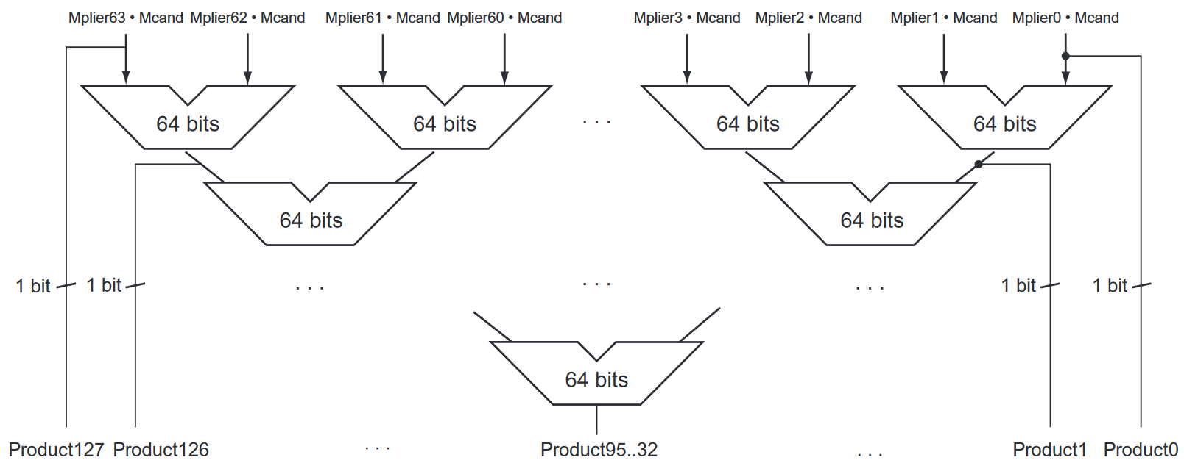

Slide 21
MIPS Multiplication
MIPS provides a separate pair of 32-bit registers to contain the 64-bit product, called Hi and Lo
To produce a properly signed or unsigned product, MIPS has two instructions:
multiply (mult) and multiply unsigned (multu)
To fetch the integer 32-bit product, the programmer uses move from lo (mflo)
Notes:
Mult has two registers operands
The result will be in $lo

